Slide 1
I/O PORTS

Slide 2
I/O PORTS
The 8051 has four I/O ports
Port 0 （pins 32-39）：P0（P0.0～P0.7）
Port 1（pins 1-8） ：P1（P1.0～P1.7）
Port 2（pins 21-28）：P2（P2.0～P2.7）
Port 3（pins 10-17）：P3（P3.0～P3.7）
Each port has 8 pins.
Named P0.X, P1.X, P2.X, P3.X （X=0,1,...,7）
Ex：P0.0 is the bit 0（LSB）of P0
Ex：P0.7 is the bit 7（MSB）of P0
These 8 bits form a byte.
Each port can be used as input or output (bi-direction).

Slide 3
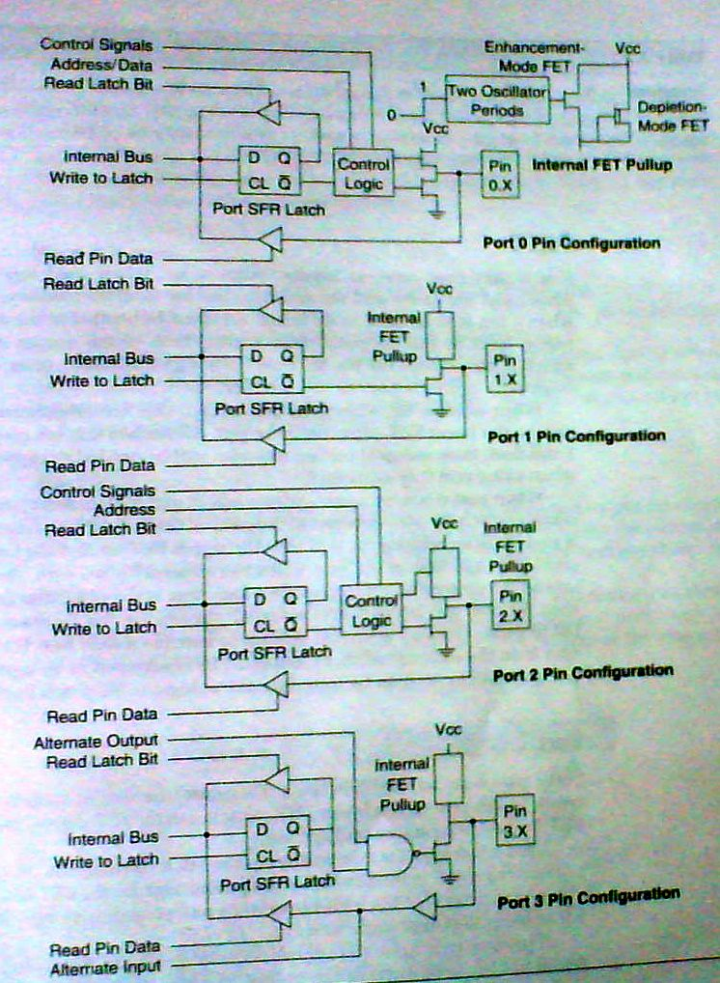

Slide 4
PORT0
When used as input, a ‘1’ must be written to corresponding port latch
Used as an output,’0’ must be programmed
Logic ‘1’ in address bit will turn Upper FET on & lower FET off
After address has formed & latched into External circuitry by ALE pulse, the External Bus is turned ON
Port 0 now reads data from External Memory
Port 0 pins can be accessed by address P0.0,P0.1,….,P0.7
It can also be addressed as AD0,AD1,…….AD7

Slide 5
PORT1
Port 1 pins have no Dual functions
If used as input a ‘1’ is written to latch which turns upper FET on
Used as output,lower FET is On & the Pullup is Off
Output latch is directly connected to gate of Lower FET
Port 1 can be accessed as P1.0,P1.1,. . . . .P1.7

Slide 6
PORT2
It can be used as I/p or o/p which is similar in operation of Port 1
The alternate use of port 2 is to supply a high-order address byte in conjunction with port 0 low-order byte to address external memory
Port 2 latches remain stable when External Memory is addressed
They do not have to be turned around (Set to 1) For Data i/p as in Port 0
It can be accessed as P2.0,P2.1,. . . . . ,P2.7

Slide 7
PORT3
It is similar to port 1,but has alternate Uses
Each pin may be individually Programmed as I/O or for alternate Functions as shown
Pin | Alternate Use SFR
P3.0-RXD | Serial data input SBUF
P3.1-TXD | Serial data Output SBUF
P3.2-INT0 | External interrupt 0 TCON.1
P3.3-INT1 | External interrupt 1 TCON.3
P3.4-T0 | External timer 0 input TMOD
P3.5-T1 | External timer 1 input TMOD
P3.6-WR | External Memory Write Pulse -
P3.7-RD | External Memory Read Pulse -

Slide 8
A Pin of Port 1
Read latch
Vcc
TB2
Load(L1)
Internal CPU bus
D Q
Clk Q
P1.X pin
P1.X
Write to latch
M1
TB1
Read pin
P1.x
8051 IC

Slide 9
Hardware Structure of I/O Pin
Each pin of I/O ports
Internal CPU bus：communicate with CPU
A D latch store the value of this pin
D latch is controlled by “Write to latch”
Write to latch＝1：write data into the D latch
2 Tri-state buffer：
TB1: controlled by “Read pin”
Read pin＝1：really read the data present at the pin
TB2: controlled by “Read latch”
Read latch＝1：read value from internal latch
A transistor M1 gate
Gate=0: open
Gate=1: close

Slide 10
Tri-state Buffer
Output
Input
Tri-state control (active high)
L
L
H
H
Low
H
H
Highimpedance (open-circuit)

Slide 11
Writing “1” to Output Pin P1.X
Read latch
Vcc
TB2
Load(L1)
2. output pin is Vcc
1. write a 1 to the pin
1
P1.X pin
Internal CPU bus
D Q
Clk Q
P1.X
0
output 1
Write to latch
M1
TB1
Read pin
8051 IC

Slide 12
Writing “0” to Output Pin P1.X
Read latch
Vcc
TB2
Load(L1)
2. output pin is ground
1. write a 0 to the pin
0
P1.X pin
Internal CPU bus
D Q
Clk Q
P1.X
1
output 0
Write to latch
M1
TB1
Read pin
8051 IC

Slide 13
Port 1 as Output（Write to a Port）
Send data to Port 1：
MOV A,#55H
BACK: MOV P1,A
ACALL DELAY
CPL A
SJMP BACK
Let P1 toggle.
You can write to P1 directly.

Slide 14
Reading Input v.s. Port Latch
When reading ports, there are two possibilities：
Read the status of the input pin. （from external pin value）
MOV A, PX
JNB P2.1, TARGET ; jump if P2.1 is not set
JB P2.1, TARGET ; jump if P2.1 is set
Read the internal latch of the output port.
ANL P1, A ; P1 ← P1 AND A
ORL P1, A ; P1 ← P1 OR A
INC P1 ; increase P1

Slide 15
Reading “High” at Input Pin
Read latch
Vcc
2. MOV A,P1
external pin=High
TB2
write a 1 to the pin MOV P1,#0FFH
Load(L1)
1
1
P1.X pin
Internal CPU bus
D Q
Clk Q
P1.X
0
M1
Write to latch
TB1
Read pin
3. Read pin=1 Read latch=0 Write to latch=1
8051 IC

